Slide 1
Arquitectura de RPA
Dr. Alejandro López Telgie: Alelopez@udec.cl
05 de noviembre 2025

Slide 2
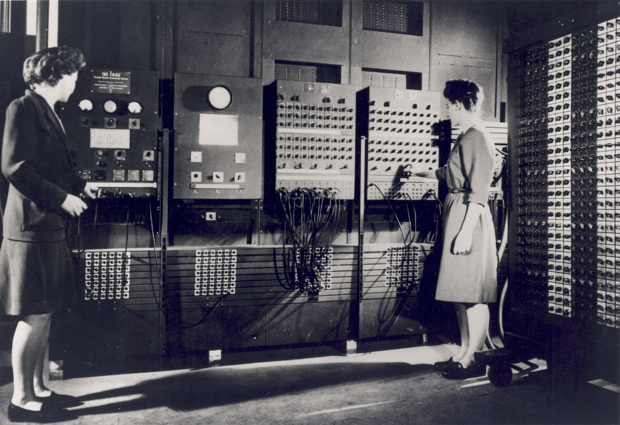
Introducción – “Is often better to define a complicated devise in terms of what it does rather than what it is”
Notes:
?1st computer ENIAC
ENIAC, acrónimo de Electronic Numerical Integrator And Computer (Computador e Integrador Numérico Electrónico),^{[1]}​^{[2]}​ fue una de las primeras computadoras de propósito general. Era Turing-completa, digital, y susceptible de ser reprogramada para resolver «una extensa clase de problemas numéricos».^{[3]}​^{[4]}​ Fue inicialmente diseñada para calcular tablas de tiro de artillería destinadas al Laboratorio de Investigación Balística del Ejército de los Estados Unidos.^{[5]}​^{[6]}​

Slide 3

Developing a Simpler Way to Build a Giant Brain Lesson 14 … SIX SIMPLE, CREATIVE SOLUTIONS THAT SHOOK THE WORLD, 4th Edition - by Tom Logsdon 2012
Simple, creative solutions are often developed by dedicated individuals with slightly above-average intelligence. But a few creative blockbusters have been proposed and perfected by world-class geniuses whose intellectual brilliance sparkles and burns with star-like luminosity.
John von Neumann – broke a high-speed digital computer apart and put it back together again (1940s). Today many of the world’s most powerful computers are still being constructed in keeping with the design philosophy he so skillfully espoused.
In 1946 he wrote a 40-page technical paper that provided the major thrust for the many advances in computer technology.
Scientists describe the operating principles of an intercontinental ballistic missile or a high-performance jet plane by breaking the device up into a series of interlocking subsystems each of which is devoted to a particular function.
Is often better to define a complicated devise in terms of what it does rather than what it is

Slide 4
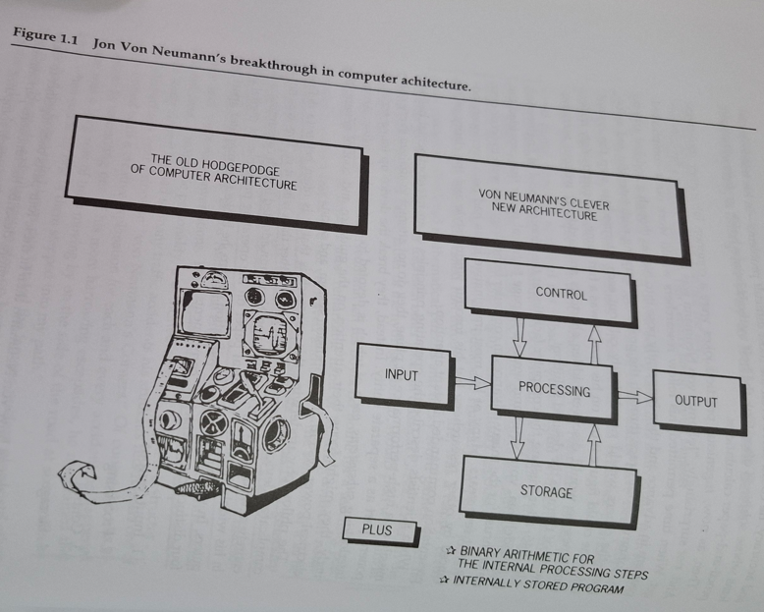
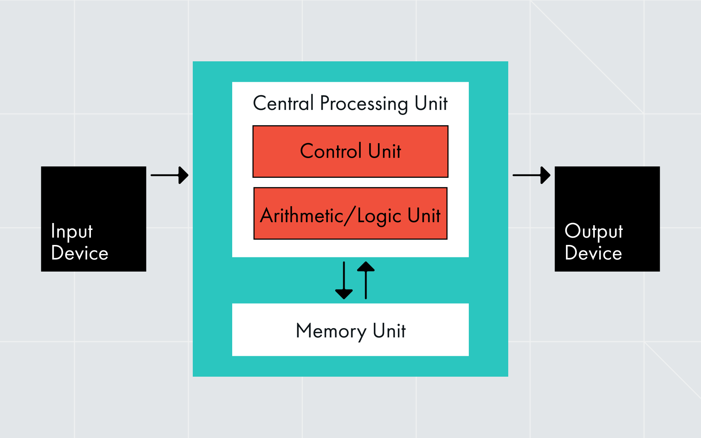
features of the digital computer [Von Neumann’s concept]
John von Neumann adopted it in his widely heralded technical paper. He broke the computer apart into four distinct, but interactive components:
Input/output
Processing
Control
Storage
https://museum.dataart.com/short-stories/john-von-neumann
Notes:
Analogo al IPO que vemos en INCOSE y NASA
The input/output devices allow the computer to communicate with the outside world in a human-oriented “language”
The processing mechanisms are the devices the computer uses to process the input values in accordance with its program instructions.
The control mechanisms cause the computer to execute the program instructions in the proper sequence with maximum practical efficiency.
The storage device are a kind of computer memory

Slide 5
The input/output devices allow the computer to communicate with the outside world in a human-oriented “language”
The processing mechanisms are the devices the computer uses to process the input values in accordance with its program instructions.
The control mechanisms cause the computer to execute the program instructions in the proper sequence with maximum practical efficiency.
The storage device are a kind of computer memory

Slide 6
resumen
John bon Neumann broke the high-speed digital computer apart and put it back together again to achieve vastly improved results.
To accomplish this goal, he defined the computer not in terms of what it is, but rather in terms of what it does.
This allowed him to break data processing machinery into four separate functions, each of which could be performed by stand-alone machines.

Slide 7
Systems Architecture Golkar (https://www.youtube.com/watch?v=gGI3n8qLDN0)

Slide 8
Architecting and engineering (Rechtin, 2002)
Engineering deals almost entirely with measurables using analytic tools derived from mathematics and the hard sciences.
Architecting deals largely with unmeasurables using non-qualitative tools and guidelines based on practical lessons learned.
“Engineering is more of a science; architecting is more of an art”
Engineering is a deductive process | Architecting is an inductive process

Slide 9
Definition of a system
A system is a construct or collection of different elements that together produce results not obtainable by the elements alone.
The elements, or parts, include people, hardware, software, facilities, policies, and documents; that is, all things required to produce systems-level results.
The results include system-level qualities, properties, characteristics, functions, behavior and performance.
The value added by the system as a whole, beyond that contributed independently by the parts, is primarily created by the relationship among the parts; that is, how they are interconnected (Rechtin, 2000).

Slide 10
Problem - compexity
Emergence is the main reason why we design engineering systems.
Emergence implies complex interactions between system elements
Complexity is the other sie of the coin of engineering systems

Slide 11
Approaches to managing complexity
Decomposition, abstraction and hierarchies
Decomposition: take the system and decompose it into parts
Hierarchies: way to structure the decomposition in a way to understand the complexity of the system
Abstractions: are used to characterize system elements in their functional and formal attributes

Slide 12
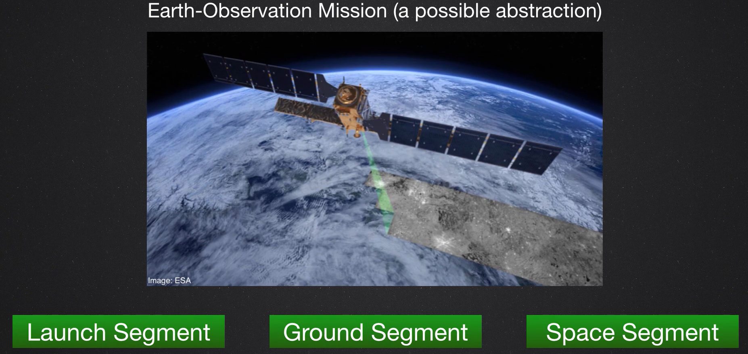
Abstraction (Crawley’s definition)
Expression of quality apart from the objects
Having only the intrinsic nature rather than the form
Abstraction can be used in both function and form
Function – thing what the system does

Slide 13
Hierarchy (crawley’s definition)
A system in which grades or classes are ranked one above the other
To manage system complexity
A way to focus yourself on the thing that really matter (as a designer)
To give a structure to system description

Slide 14
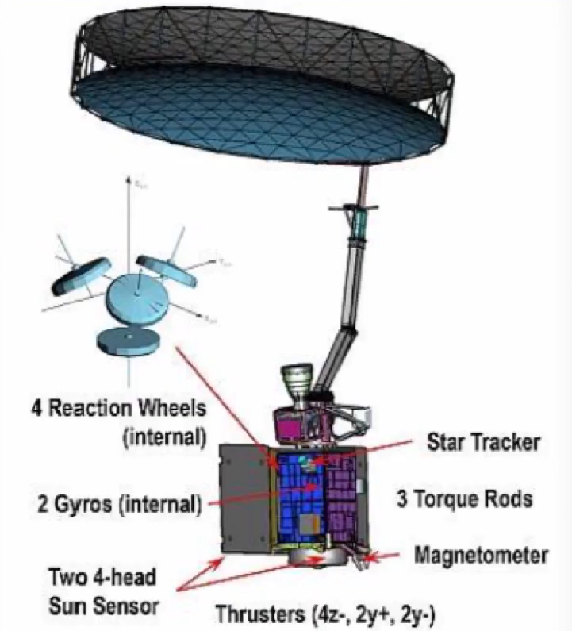
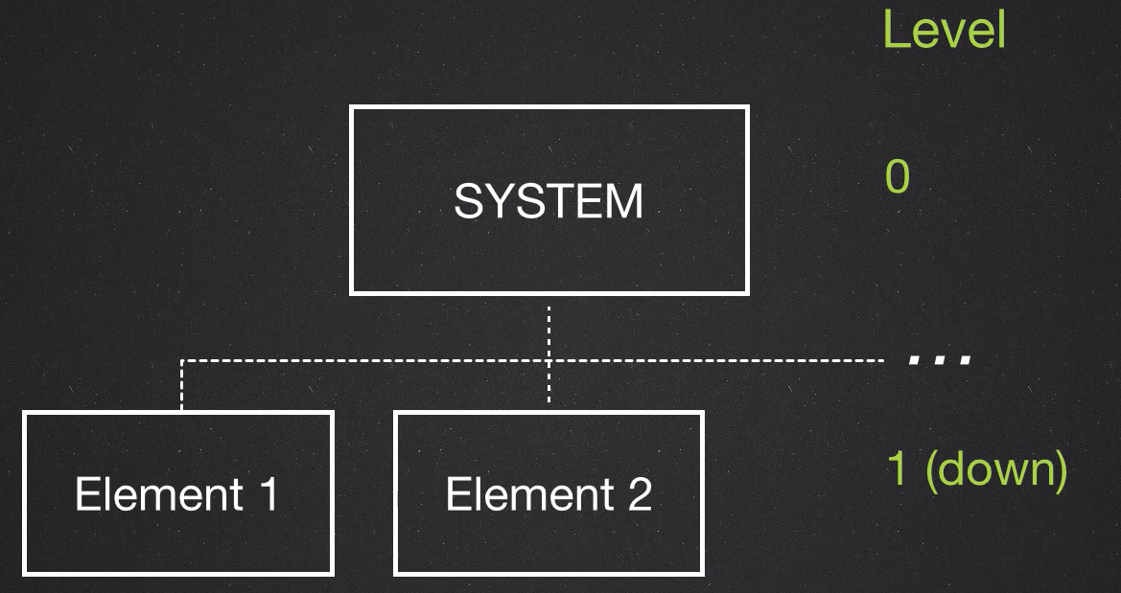
Decomposition (crawley’s definition)
Is the division into smaller constituents

Slide 15
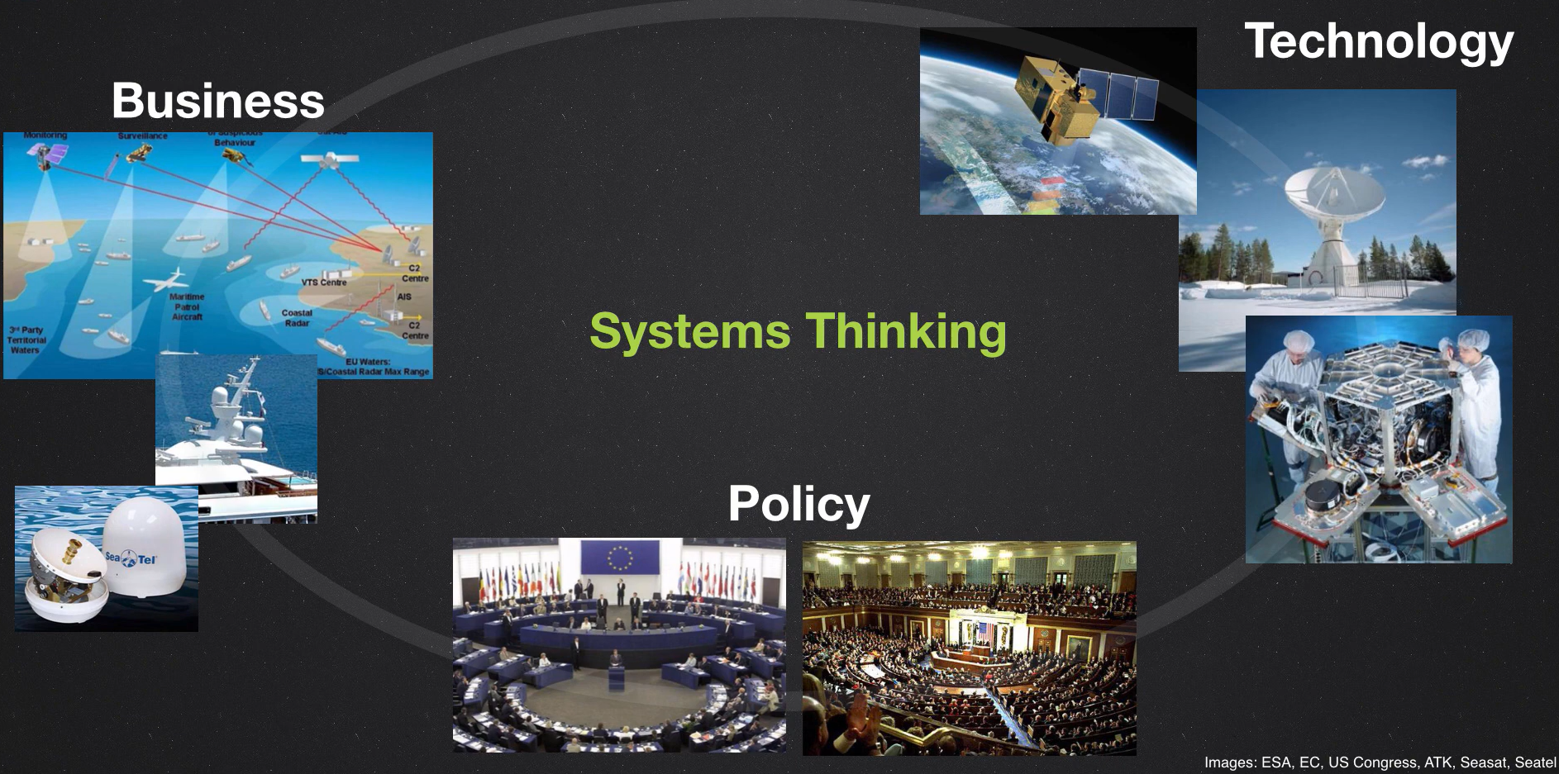
Systems thinking
Holistic Approach to architect engineering systems and manage complexity
Considers: Technology, business, and policy

Slide 16
Principles of architecture
Three of the most important ones are:
Elegance
Traceability
Occam’s razor

Slide 17
Elegance
In system architecture is to find the simplest solution to complex problems
Elegance implies minimizing functions, elements, and interfaces of a concept, while still satisfying stakeholders needs

Slide 18
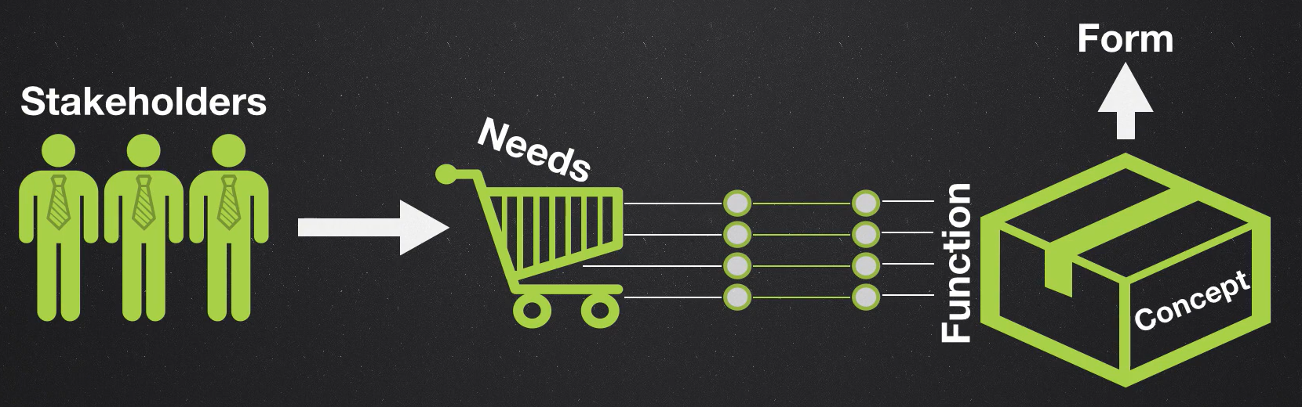
Traceability
It means that whatever function that you imbed in your system it must be traceable, must be produced to a specific stakeholder needs
Fucus on value-associated operands

Slide 19
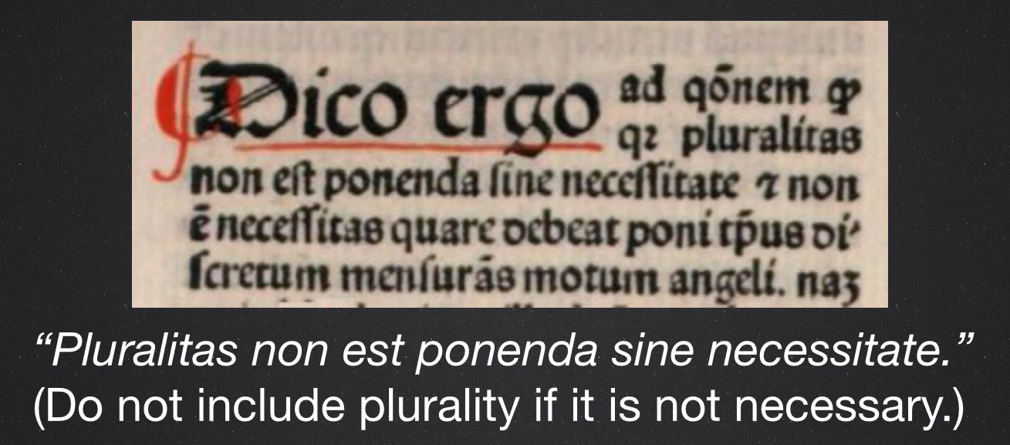
Occam’s razor
William of occam – Franciscan friar and scholastic philosopher.
Good concepts are simple, lean, elegant

Slide 20
Decomposition

Slide 21
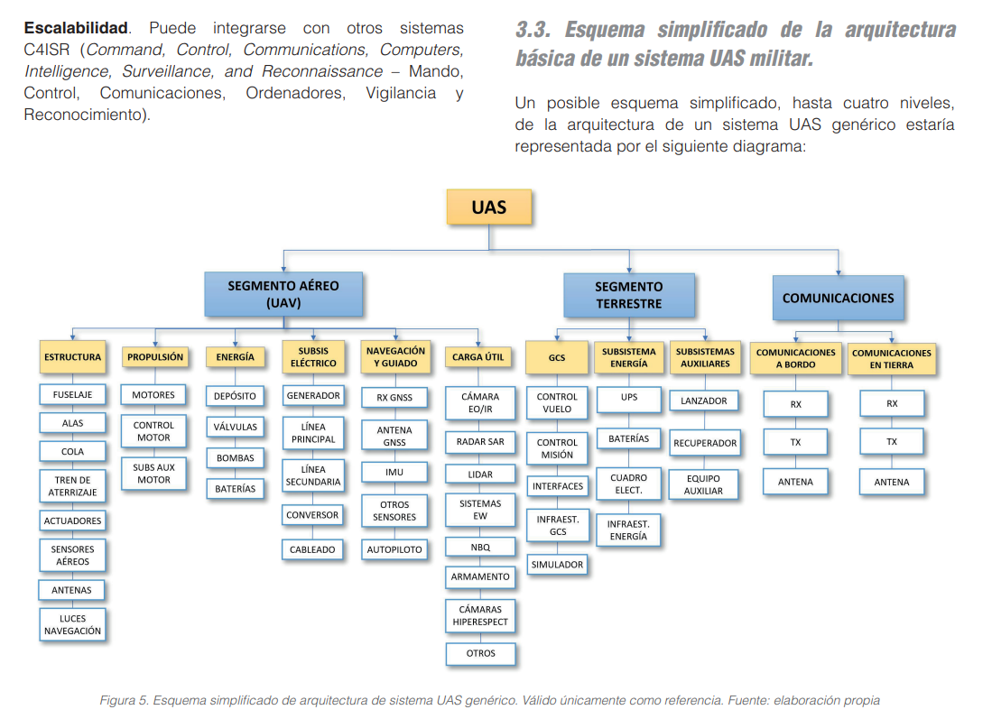
Esquema simplificado de la arquitectura básica de un sistema UAS militar

Slide 22
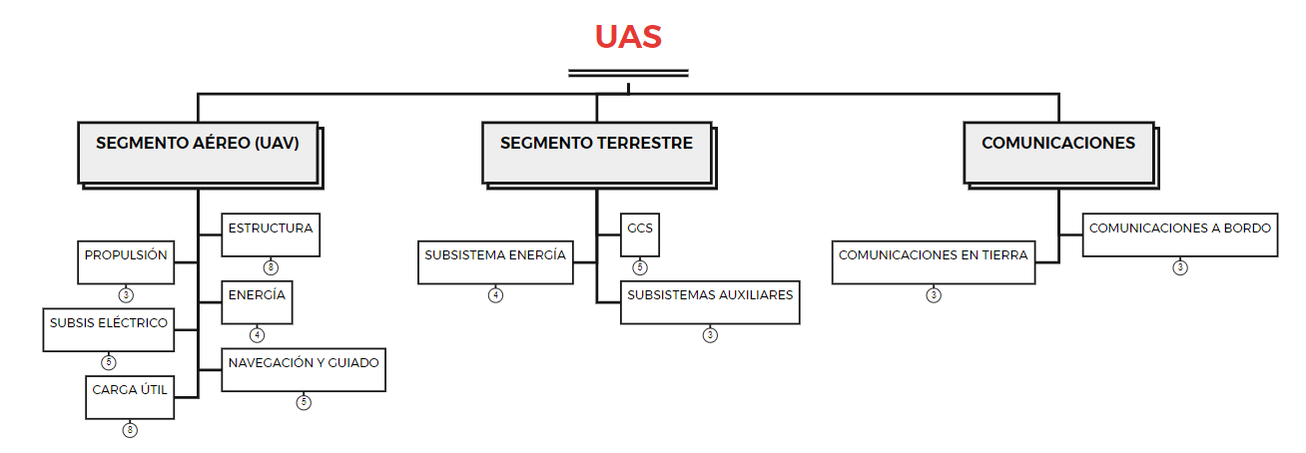
Esquema simplificado de la arquitectura básica de un sistema UAS militar

Slide 23
Gracias alelopez@udec.cl

